Slide 1
Applied Geographic Information Systems and GIS Programming Day 6: Accessibility Analysis
Yi Qiang
Department of Geography
University of Hawaii - Manoa

Slide 2
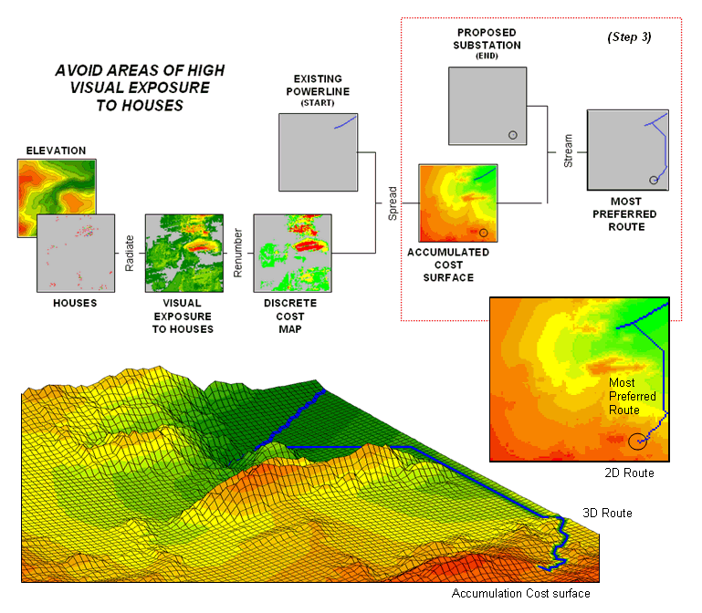
Example of Least Cost Path Analysis

Slide 3
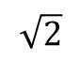
Distance in Raster
Source cell
1
2 | 1 | 0
2.24 | 1.41 | 1
28.3 | 2.24 | 2
$$\sqrt{2}$$
Cell size = 1
1

Slide 4
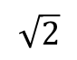
Distance in Raster
If travel cost per distance unit is constant, the least cost path is straight line from one cell (center) to the other.
Source cell
1
2 | 1 | 0
2.24 | 1.41 | 1
28.3 | 2.24 | 2
$$\sqrt{2}$$
Cell size = 1
1
Distance from source to all other cells

Slide 5
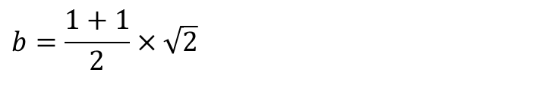
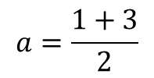
Cost distance
The travel can only be perpendicular or diagonal
If travel cost per distance unit is varying.
3 | 3 | 1
2 | 1 | 1
2 | 1 | 1
Perpendicular
a
$$a=\frac{1+3}{2}$$
Diagonal
Diagonal
b
$$b=\frac{1+1}{2}×\sqrt{2}$$
Perpendicular
Perpendicular
Diagonal
Diagonal
Perpendicular
Cost surface: changing cost in different cells

Slide 6
Cost distance
The travel can only be perpendicular or diagonal
If travel cost per distance unit is varying.
Perpendicular
Diagonal
Diagonal
Perpendicular
Perpendicular
Diagonal
Diagonal
Perpendicular

Slide 7
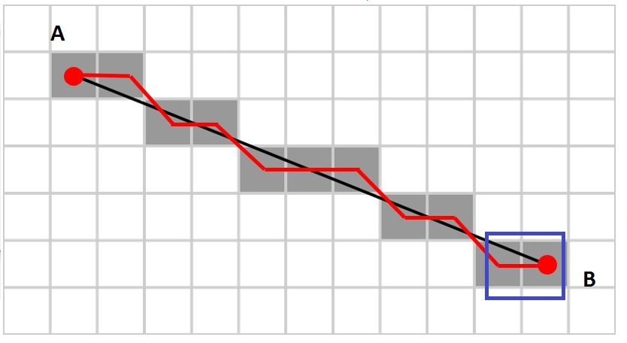
Cost distance
The travel can only be perpendicular or diagonal
If travel cost per distance unit is varying.
Perpendicular
Diagonal
Diagonal
Perpendicular
Perpendicular
Diagonal
Diagonal
Perpendicular
Travel path between two points in raster

Slide 8
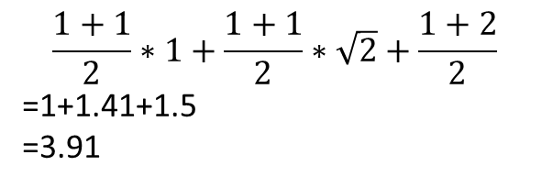
Cost distance
Which is the best path (least cost)?
Depends on (1) length of path; (2) cost of path
3 | 3 | 1
2 | 2 | 1
2 | 1 | 1
3 | 3 | 1
2 | 2 | 1
2 | 1 | 1
Source
Source
Destination
Destination
$$\frac{1+1}{2}∗1+\frac{1+1}{2}∗\sqrt{2}+\frac{1+2}{2}$$
=1+1.41+1.5
=3.91

Slide 9
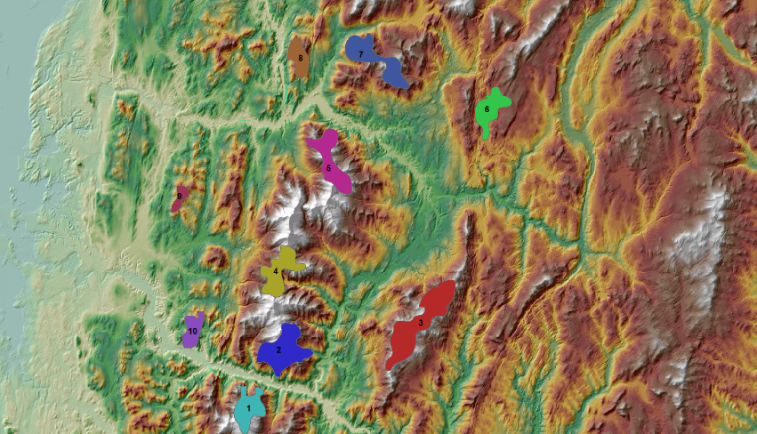
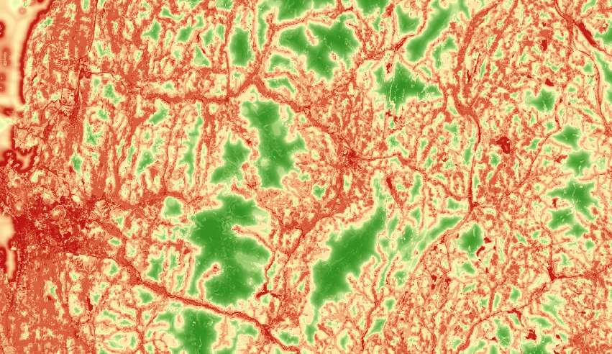

How to perform the cost distance analysis
Sources
Cost surface (cost per distance unit)
Accumulative cost distance (accumulative cost from the source to all other cells)

Slide 10
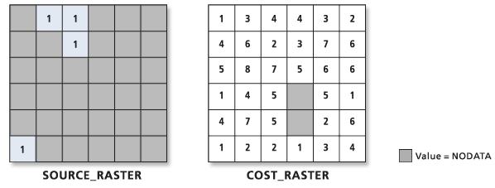
How to calculate accumulative distance cost
An iterative process that begins with the source cells.
The goal of each cell is to be assigned quickly to the output cost-distance raster.
Detailed description:
http://help.arcgis.com/en/arcgisdesktop/10.0/help/index.html#/How_the_cost_distance_tools_work/009z00000025000000/
The inputs:
(Source)
(Cost surface)

Slide 11
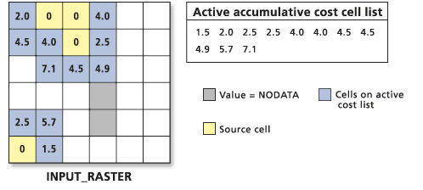
How to calculate accumulative distance cost
In the first iteration, the source cells are identified and assigned 0.
Next, all the source cell's neighbors are activated, and a cost is assigned to the links between the source cell nodes and the neighboring cells' nodes using the above accumulative cost formulas.
The accumulative cost values are arranged in a list from the lowest accumulative cost to the highest.

Slide 12
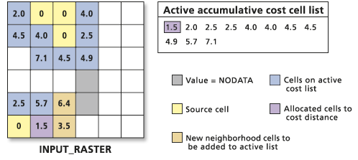
How to calculate accumulative distance cost
The lowest cost cell is chosen from the active accumulative cost cell list, and the value for that cell location is assigned to the output cost-distance raster.
The list of active cells expands to include the neighbors of the chosen cell, because those cells now have a way to reach a source.
Only those cells that can possibly reach a source can be active in the list. The cost to move into these cells is calculated using the accumulative cost formulas.

Slide 13
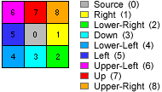
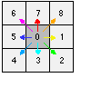
How to calculate accumulative distance cost
Backline
The direction of least cost path from each cell to their neighborhood
In each iteration, the back-line direction of cells added to the cost distance will be saved in another raster
Backline direction
Direction coding

Slide 14
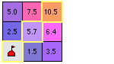
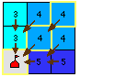
How to calculate accumulative distance cost
Backline
The direction of least cost path from each cell to their neighborhood
In each iteration, the back-line direction of cells added to the cost distance will be saved in another raster
Cost surface
Backline to the source

Slide 15
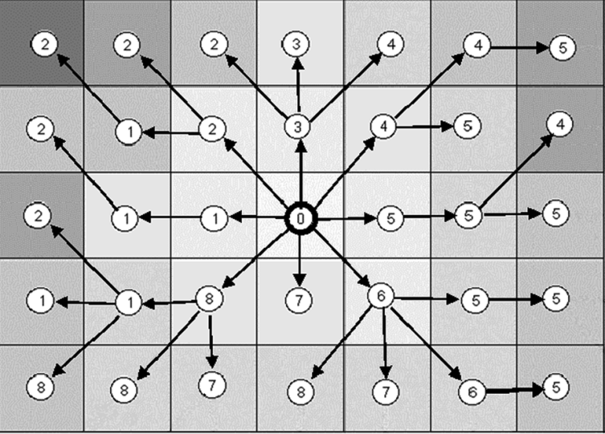
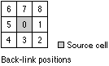
How to calculate accumulative distance cost
Backline
The direction of least cost path from each cell to their neighborhood
In each iteration, the back-line direction of cells added to the cost distance will be saved in another raster
Backline raster

Slide 16
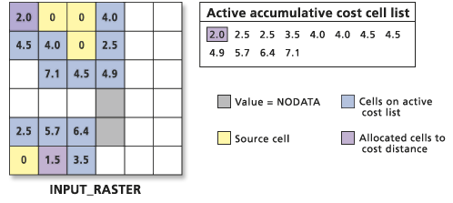
How to calculate accumulative distance cost
Again, the active cell on the list with the lowest cost is chosen, the neighborhood is expanded, the new costs are calculated, and the new cost cells are added to the active list.

Slide 17
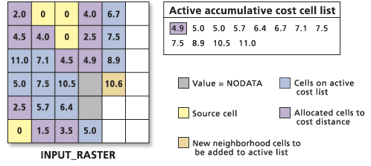
How to calculate accumulative distance cost
This allocation process continues. The lowest cells in the active list are added to the output raster one by one.
The neighborhood of the lowest active cell expand and are added to the list.

Slide 18
How to calculate accumulative distance cost
The process continues…

Slide 19
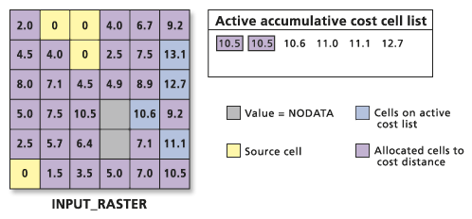
How to calculate accumulative distance cost
Until all cells in the raster are added to the output.

Slide 20
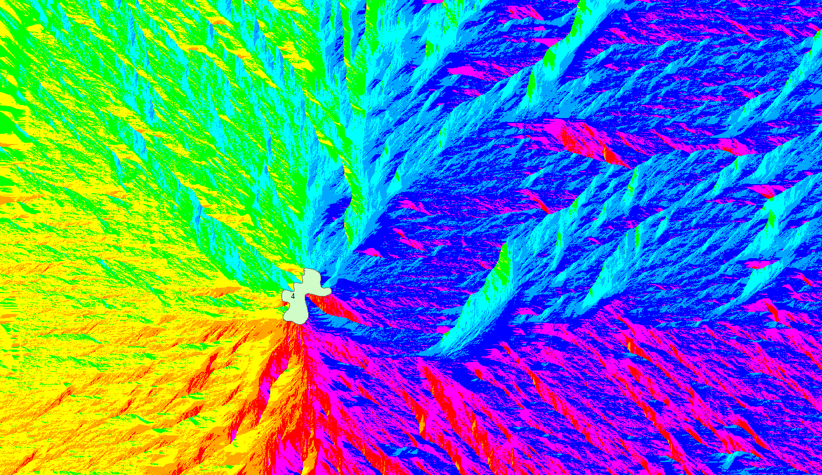
Outputs:
Accumulative cost distance
Backline of the

Slide 21
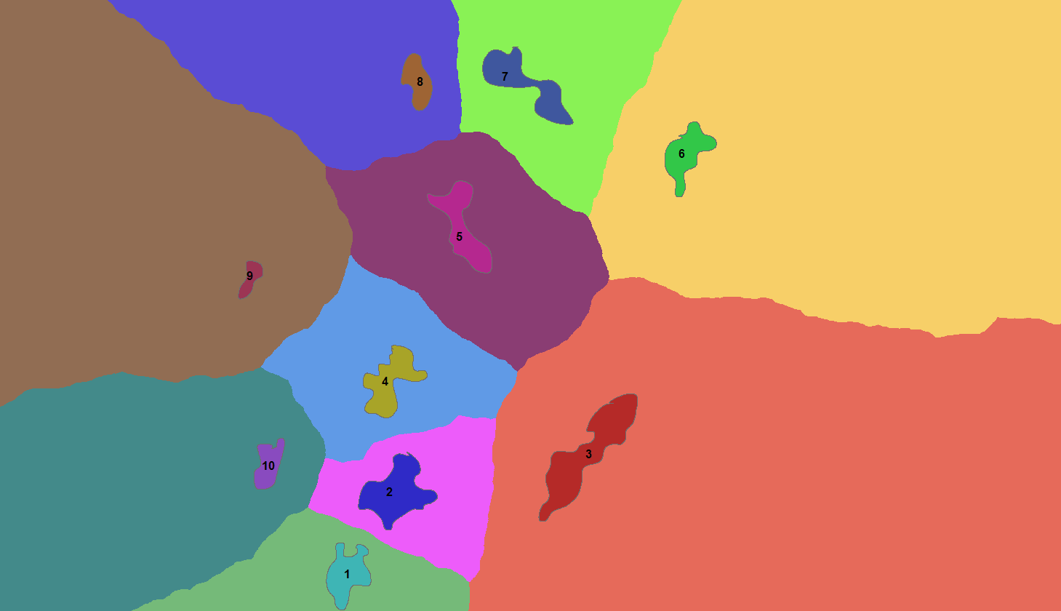
Cost allocation
An overlay of accumulative cost distance of multiple sources
Each zone contains pixels that have the same source of lowest cost path
Can be used for service zone delineation

Slide 23
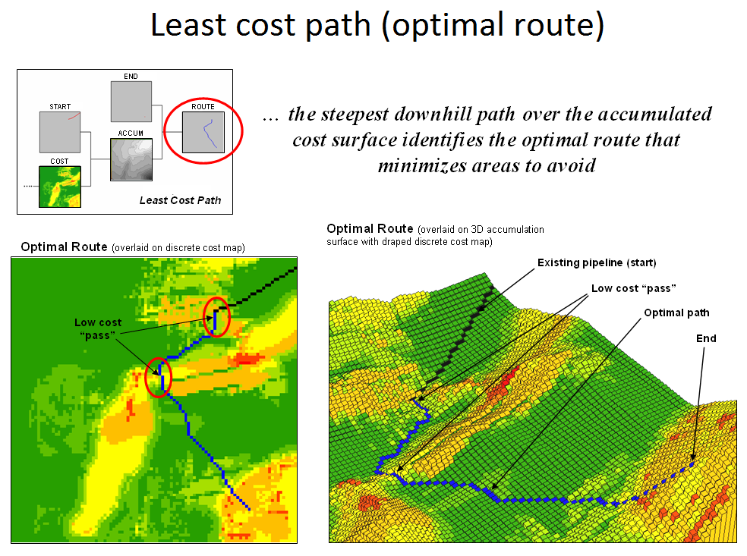

Slide 24
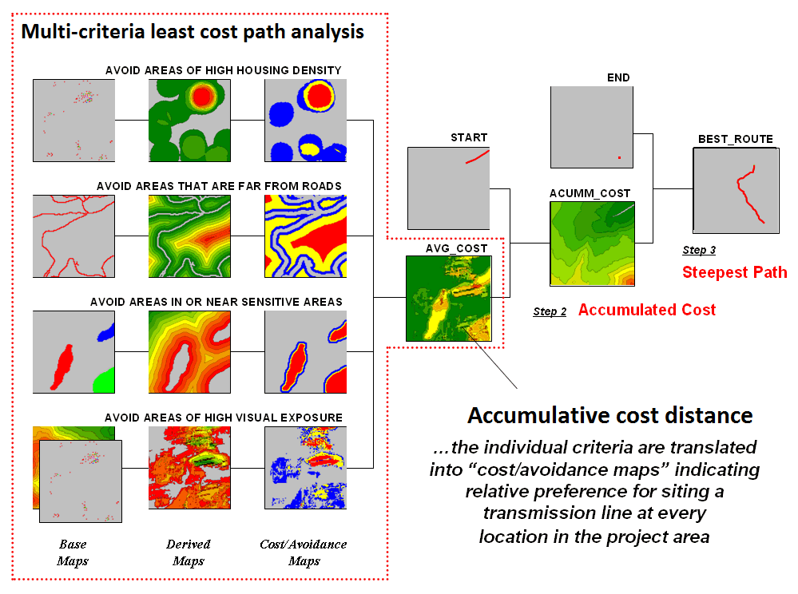

Slide 25
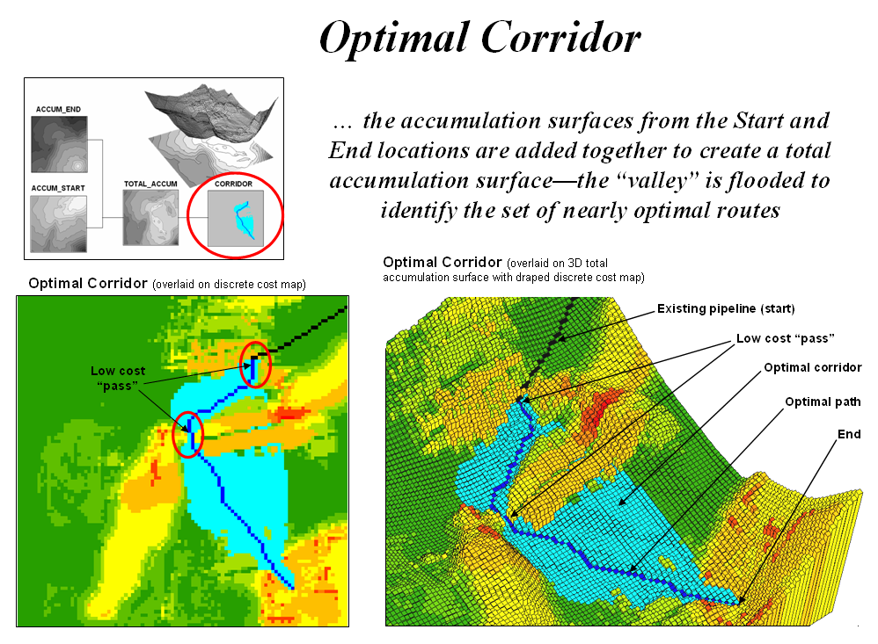
The optimal corridor identifies the N^{th} best route. These form a set of “nearly optimal” alternative routes that a siting team might want to investigate.

Slide 26
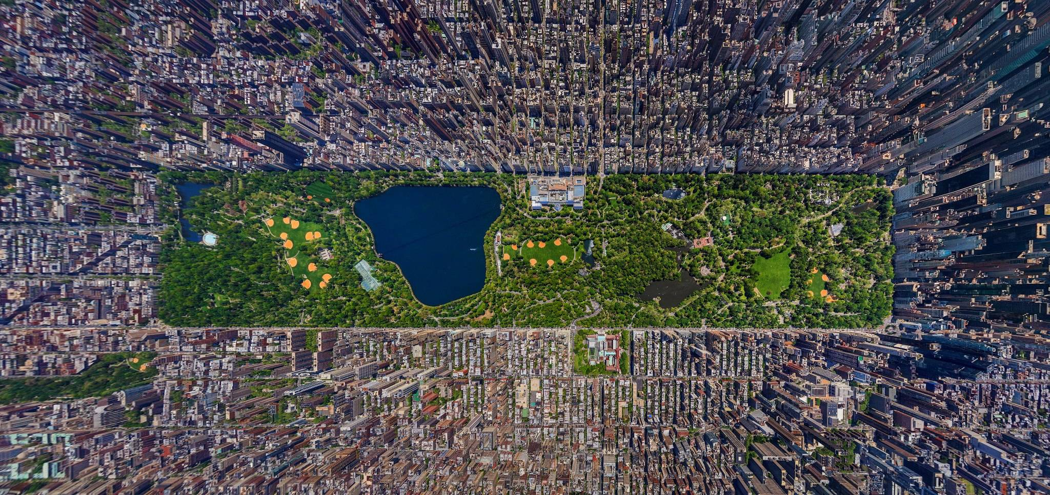
Network analysis
Birdseye view of Manhattan

Slide 27
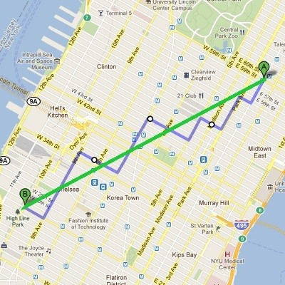
Euclidean distance vs Manhattan distance
Travel route in Manhattan

Slide 28
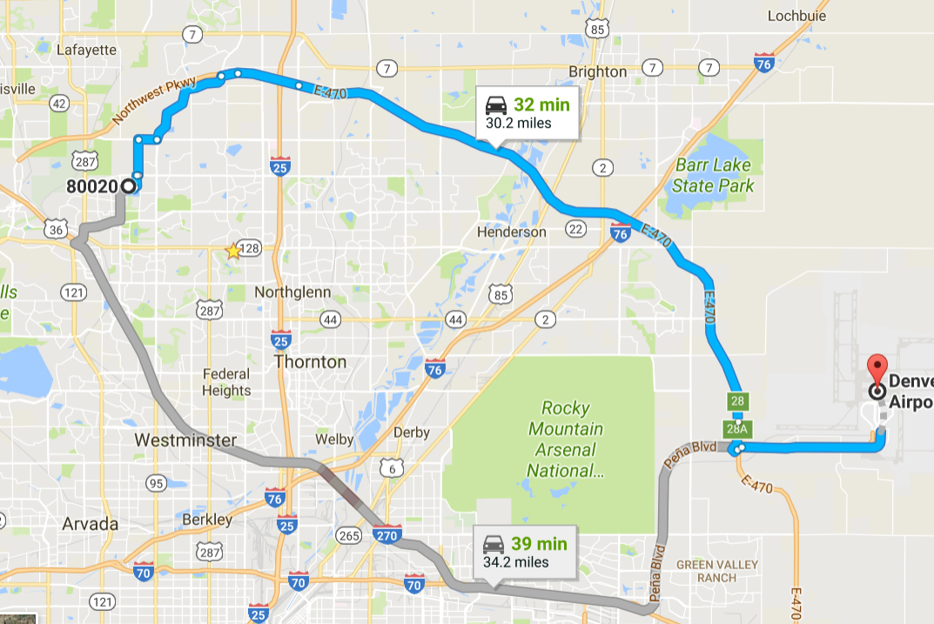
Not only road network, but also the level (speed, toll charge) of road matters.

Slide 29
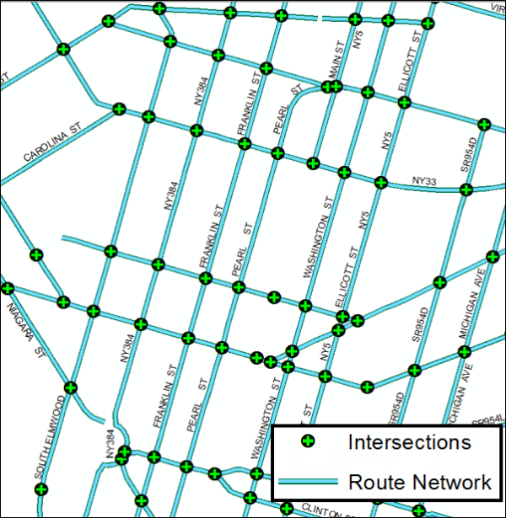
Network in GIS
Edges
Represented as polylines
A 1-D linear space where moving objects can travel
Length, speed, and direction of travel
Junctions (intersections):
Define the connectivity of road
Define the turning restrictions

Slide 30
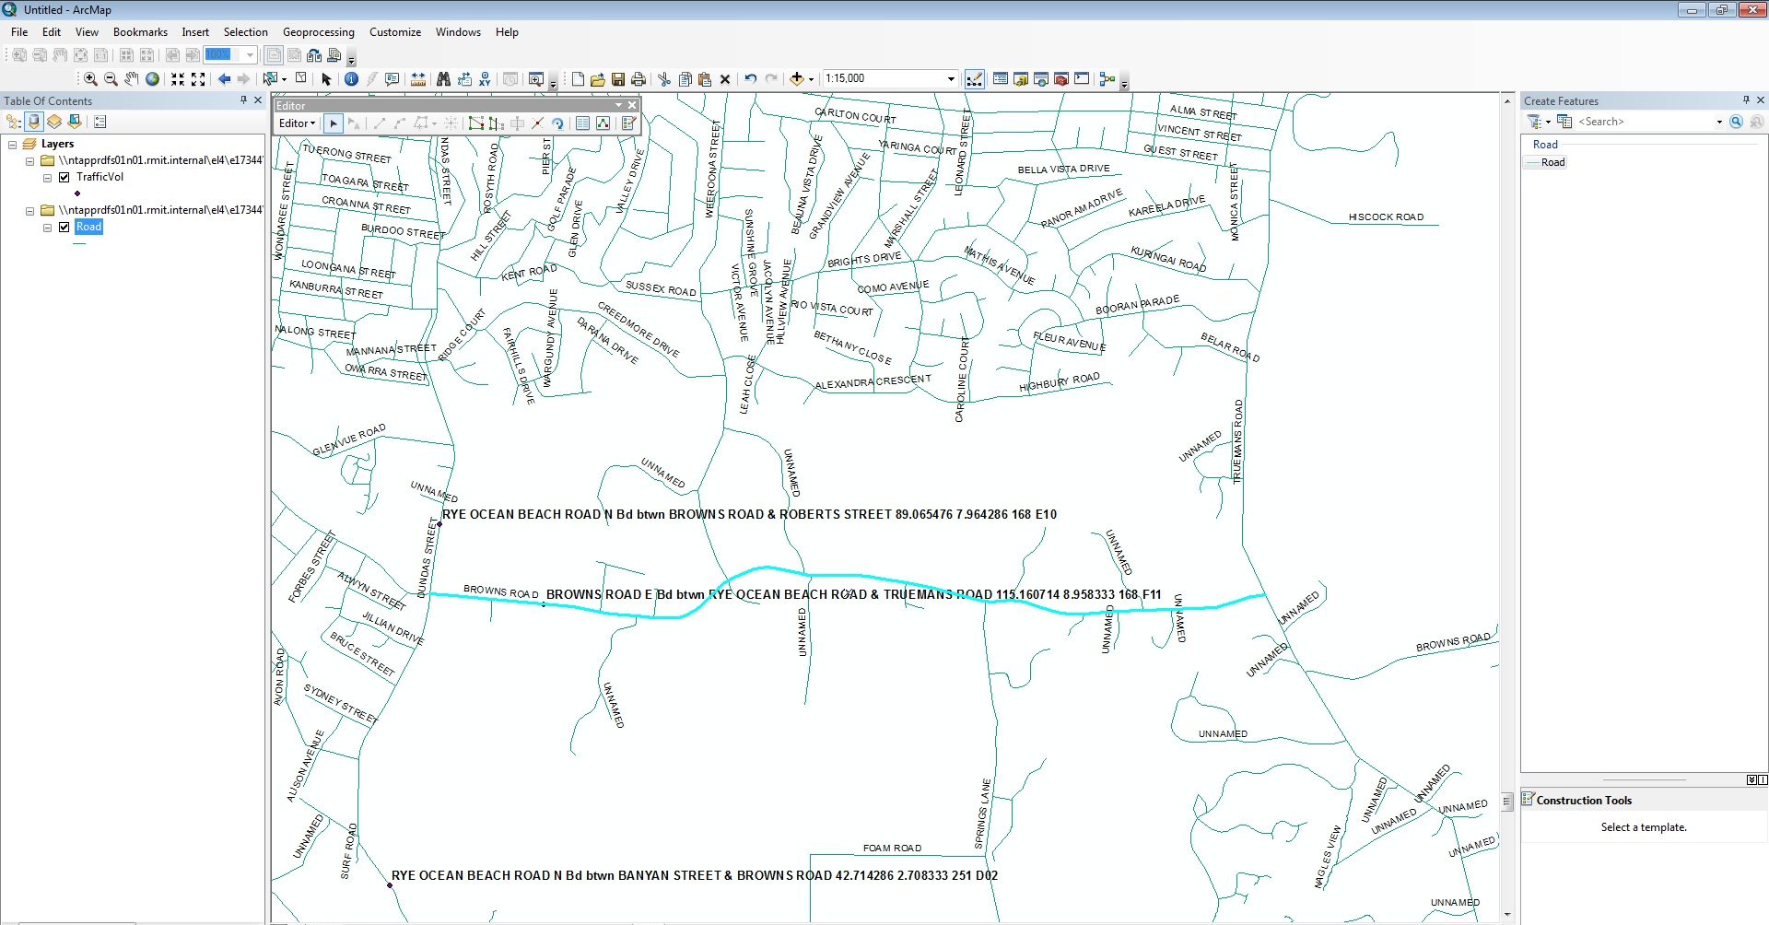
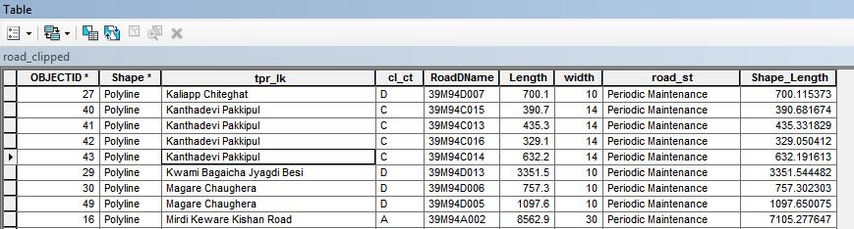
Road network in GIS
Road are represented as polylines
Attribute table stores road information

Slide 31
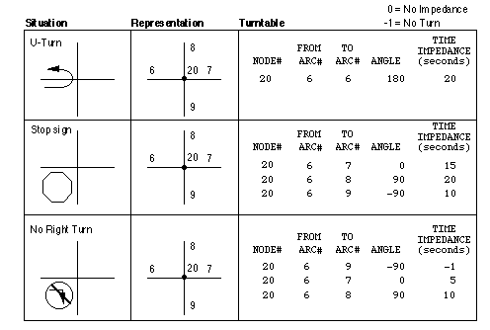
Network in GIS
Junctions between roads

Slide 32
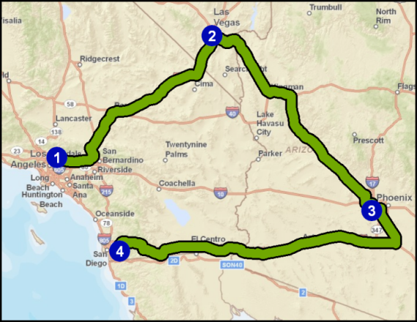
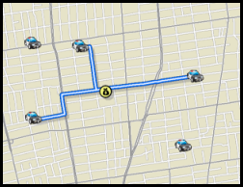
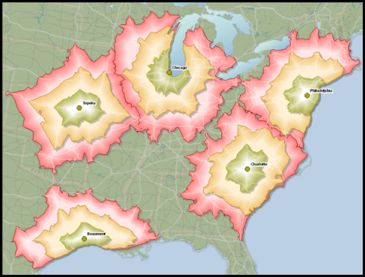
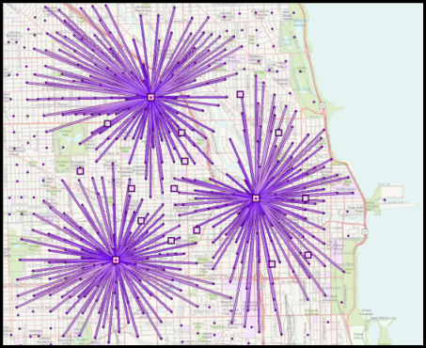
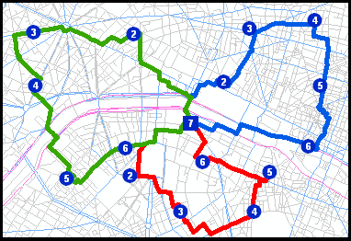
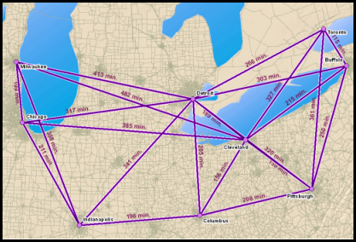
Common Network Analyses in GIS
Route
Closest Facility
Service Area
Location-Allocation
Vehicle Routing
Problem
Origin-Destination
Cost Matrix

Slide 33
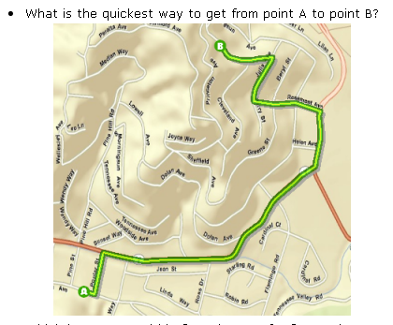
Finding the best path: Drive Time or Distance

Slide 34
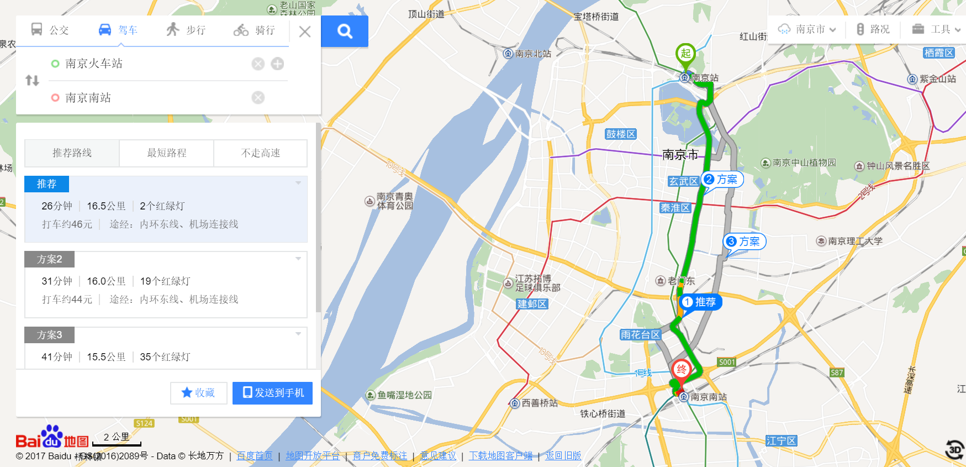
Best path can have different criteria

Slide 35
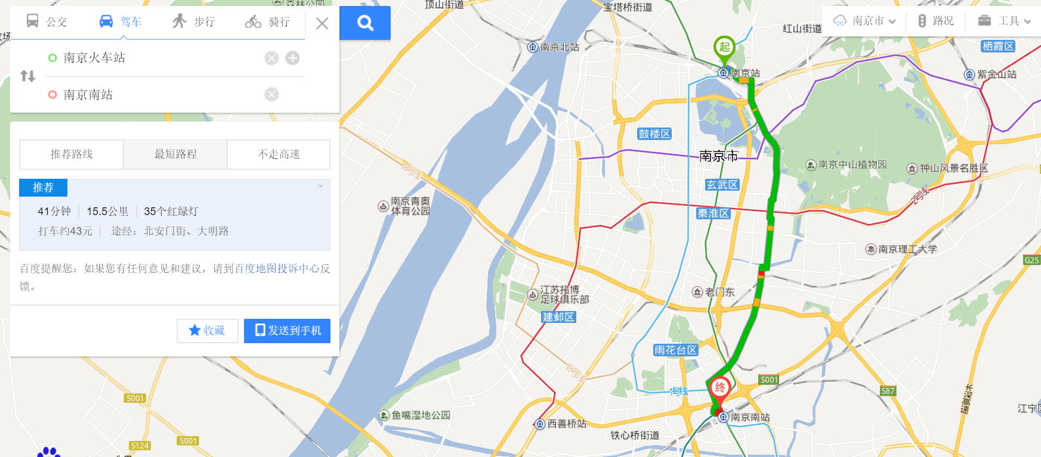
Best path can have different criteria

Slide 36
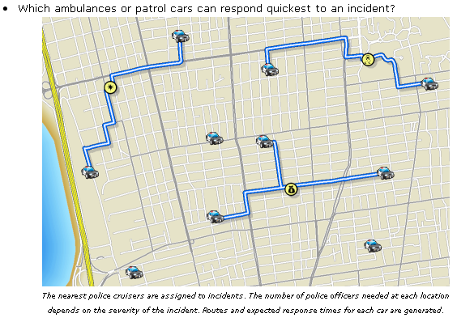
Closest facility
Find the closest facility to the destination within a road network

Slide 37
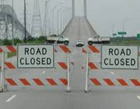
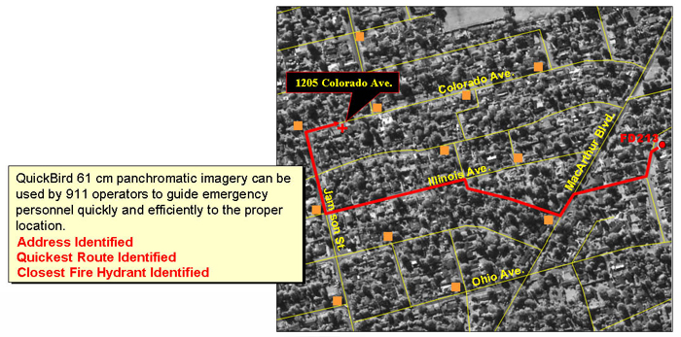
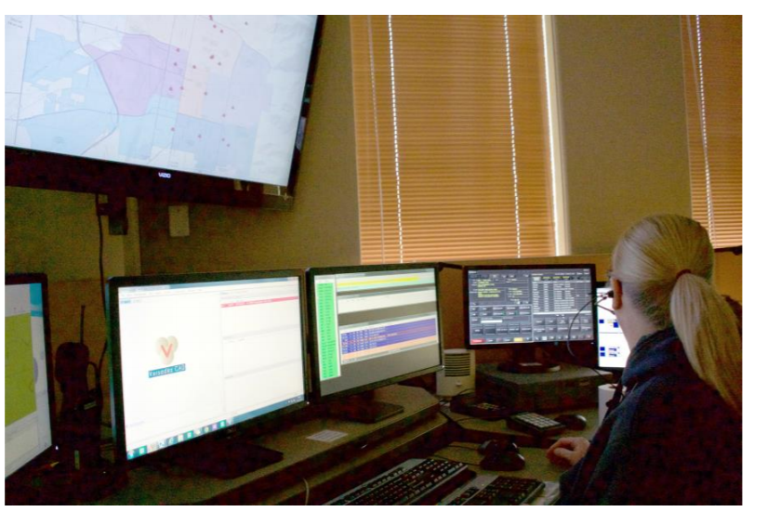
Closest facility
Emergency response:
Police and ambulance dispatch
Resource management and allocation
Taxi and delivery management
Traffic control can be planned simultaneously
911 call center with a GIS of real-time locations of response crew
Closest response team and best route can be calculated using network analysis in a GIS

Slide 38
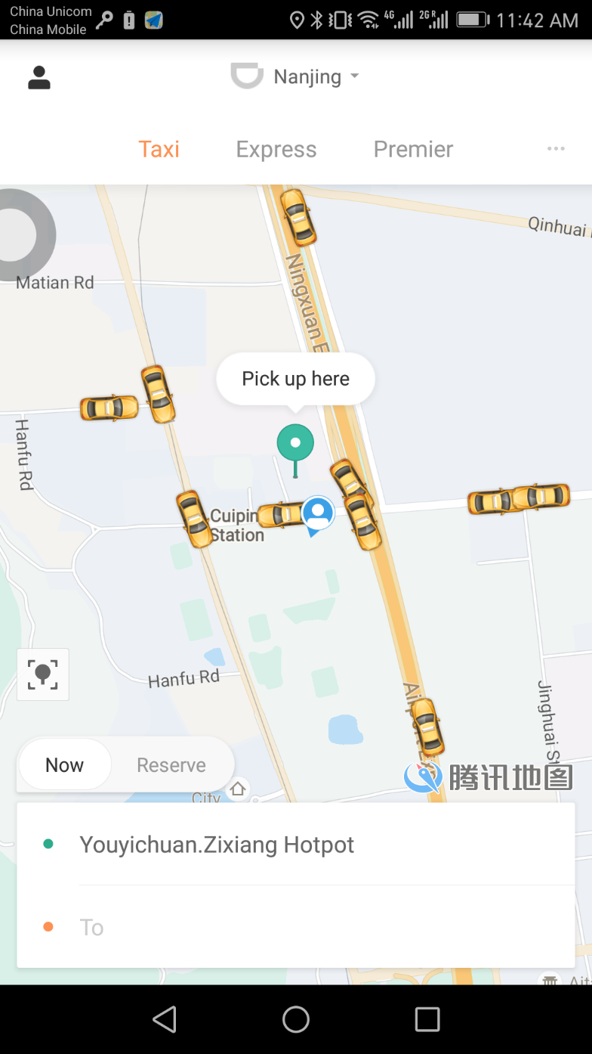
Closest facility
Emergency response:
Police and ambulance dispatch
Resource management and allocation
Taxi and delivery management
Finding the closest Taxi to a calling customer

Slide 39
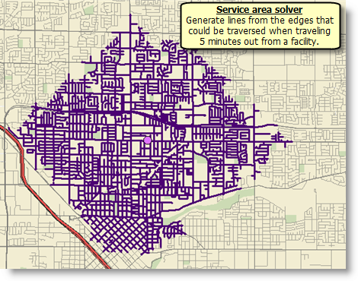
Service Area
Similar to buffer analysis in Euclidean Distance
Usually use travel time as the threshold

Slide 40
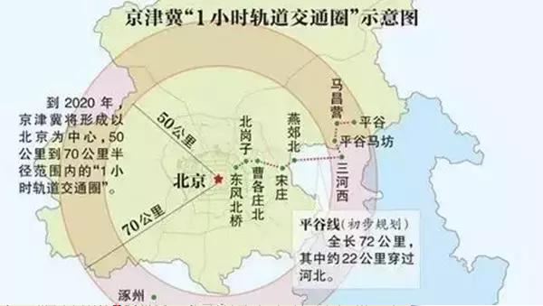
Service area (commuting range) of cities
One-hour commuting circle of Beijing (not based on network analysis)

Slide 41
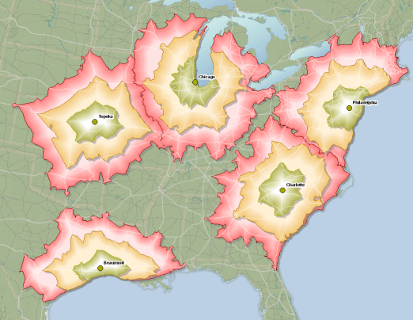
Service Area
Service area of cities based on network analysis

Slide 42



Barriers in network analysis
Restriction barrier (point)
Cost point barrier (polygon)
Restriction barrier (polygon)

Slide 43


Examples of barriers in Network Analysis
Barrier (storm) affect shortest path
Barrier (river) affect service area

Slide 44


Service Area
Evaluating the economic benefit of new transportation project
Hong Kong – Zhuhai – Macau Bridge

Slide 45

Service Area
Evaluating the economic benefit of new transportation project
With the new bridge, Macau and Hong Kong will be in 1-hour commuting area between each other
3.5 hours from Hong Kong to Macau

Slide 46
Location Allocation
Given facilities that provide goods and services and a set of demand points that consume them, the goal of location-allocation is to locate the facilities in a way that supplies the demand points most efficiently.
As the name suggests, location-allocation is a twofold problem that simultaneously locates facilities and allocates demand points to the facilities.
It is essentially an optimization problem. Standards include
Minimize impedance
Maximize coverage
Maximize capacitated coverage
Minimize facilities
Maximize attendance
Maximize market share
Target market share

Slide 47
Location Allocation
A retail store wants to see which potential store locations would need to be developed to capture 10 percent of the retail market in the area.
A fire department wants to determine where it should locate fire stations to reach 90 percent of the community within a four-minute response time.
A police department wants to preposition personnel given past criminal activity at night.
After a storm, a disaster response agency wants to find the best locations to set up triage facilities, with limited patient capacities, to tend to the affected population.

Slide 48

Location-Allocation
Example: Allocating limited triage locations to cover most population
After a storm, a disaster response agency wants to find the best locations to set up triage facilities, with limited patient capacities, to tend to the affected population.

Slide 49

Location-Allocation
Example: Finding best locations for new retail stores
Maximize the coverage of potential customers
Minimize the overlap with existing retail stores

Slide 50

Vehicle Routing Problem (travelling salesman problem)
Given multiple destinations, find the best route to pass all of them.
Examples:
For example, a large furniture store might use several trucks to deliver furniture to homes.
A specialized grease recycling company might route trucks from a facility to pick up used grease from restaurants.
A health department might schedule daily inspection visits for each of its health inspectors.
Simplified graph of travelling salesman problem with four cities

Slide 51

Vehicle Routing Problem
Different objectives can be different
Minimize the global transportation cost based on the global distance travelled as well as the fixed costs associated with the used vehicles and drivers
Minimize the number of vehicles needed to serve all customers
Least variation in travel time and vehicle load
Minimize penalties for low quality service

Slide 52


Origin-Destination Cost Matrix Analysis

Slide 53

Space-Time Cube
Travel is change of position at different times
In GIS, time can be added as the third dimension (z-axis) on top of the 2D space, which forms a space-time cube (3D)

Slide 54


Space-Time Cube
Napoleon's March in 1812 (by Charles Joseph Minard)
Napoleon's March in Space- Time Cube

Slide 55

Space-Time Cube
Travel path in a 2D map
Travel path in a space-time cube

Slide 56

A visualization tool for travel behavior analysis
Stacked space-time density of animal trajectories.
Space-time cube representation of one month of trajectories of one individual bird. The x-y plane represents geographic space and the z-axis is time (0-24 hrs).
b) Brownian stacked space-time density of the trajectories from the space-time cube.
c) Gaussian stacked space-time density of the same data and
d) isosurface of the highest values in the Gaussian density, indicating a temporal column and a space-time hotspot.

Slide 57

Space-Time Prism
For a person at Location A at t1, the maximum travel range if he is required to return to that location at t2.
For example, a person who can leave his office at 12pm for lunch but must return by 2pm for the afternoon. Which restaurant he can go?
The prism include all possible location of the person in space and time.
The opening angle of the prism is dependent on travel speed.
The circle is the maximum range the people can reach

Slide 58

Space-Time Prism
For a person at Location A at t1, the maximum travel range if he needs to conduct an activity for a certain length of time and travel back to Location B at t2.
For example, a person who can leave his office at 6pm for dinner for 1 hour and must return back home by 10pm. Which restaurant he can go?

Slide 59

Space-Time Prism
The maximum range of meet for two persons.
For example:
John leaves his office at Location A at 6pm and needs to return to Location B at 10pm,
Mike leaves his office at Location C at 5pm and needs to return to location D at 11pm,
What’s the maximum range of their meeting place?

Slide 60
Tomorrow’s class
Lab Exercise at No. 1 Building, 21st floor, Room 101

